Slide 1

Health Care Satisfaction Analysis
Evaluating patient satisfaction across U.S. hospitals to uncover insights into ratings, response rates, and satisfaction trends for healthcare improvement.

Slide 2

Project Overview
Mission
Approach
Evaluate patient satisfaction levels across U.S. hospitals to identify improvement areas and benchmark facilities effectively.
Comprehensive analysis using data cleaning, SQL querying, and interactive visualization to uncover actionable insights for healthcare consultants.

Slide 3

Technology Stack
Microsoft Excel
MySQL (XAMPP)
Data cleaning, preprocessing and exploration
Database setup and advanced SQL querying
Power BI
Python
Data visualization and dashboard development
Data transformation using Pandas and SQLAlchemy

Slide 4

Data Source & Structure
Dataset
Healthcare_Survey.xlsx from CMS Hospital Compare
Key Fields
State, Facility ID, Zip Code
HCAHPS Questions & Categories
Patient Survey Star Rating
Response Rate (%)

Slide 5
Python Data Preparation
01
02
Data Loading & Exploration
Column Standardization
Imported dataset using pandas, checked structure with df.info() and summary statistics
Renamed columns to snake_case for better readability and documentation
03
04
Feature Engineering
Database Integration
Created Survey_Period_Days, Response_Rate_Category, Satisfaction_Level, Rating_to_Response_Ratio, Question_Category, and Top_Performance columns
Connected Python to MySQL and loaded cleaned DataFrame for SQL analysis

Slide 6
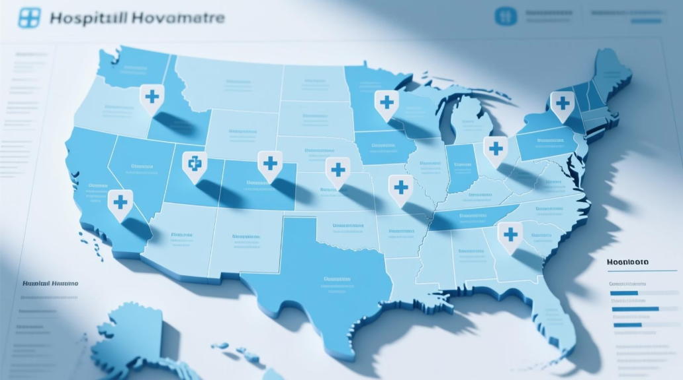


SQL Analysis Highlights
Hospital Coverage
Performance Metrics
Trend Analysis
Analyzed total hospitals and distribution across states
Evaluated star ratings, satisfaction levels, and response rates by state
Identified year-wise performance trends and underperforming facilities

Slide 7

Top Performing States
1st
2nd
3rd
Texas
California
Florida
Highest number of healthcare facilities
Second largest hospital network
Third in facility count nationwide

Slide 8
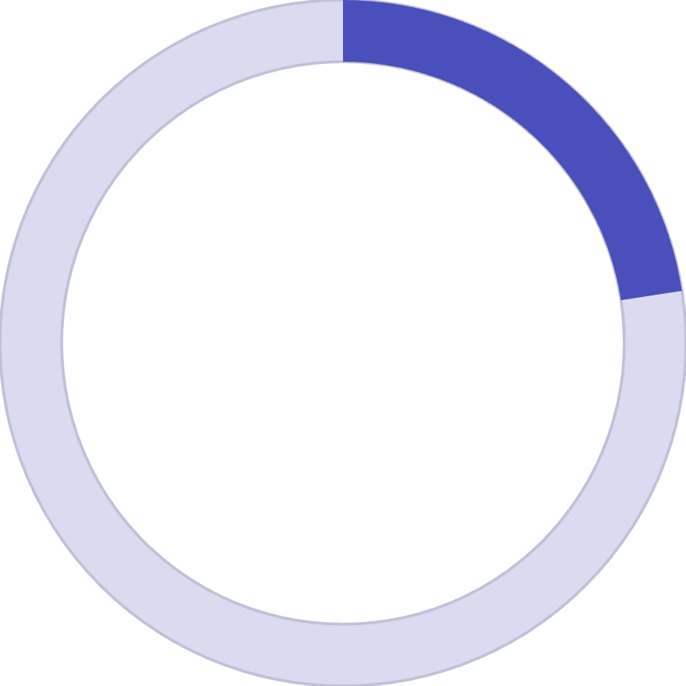
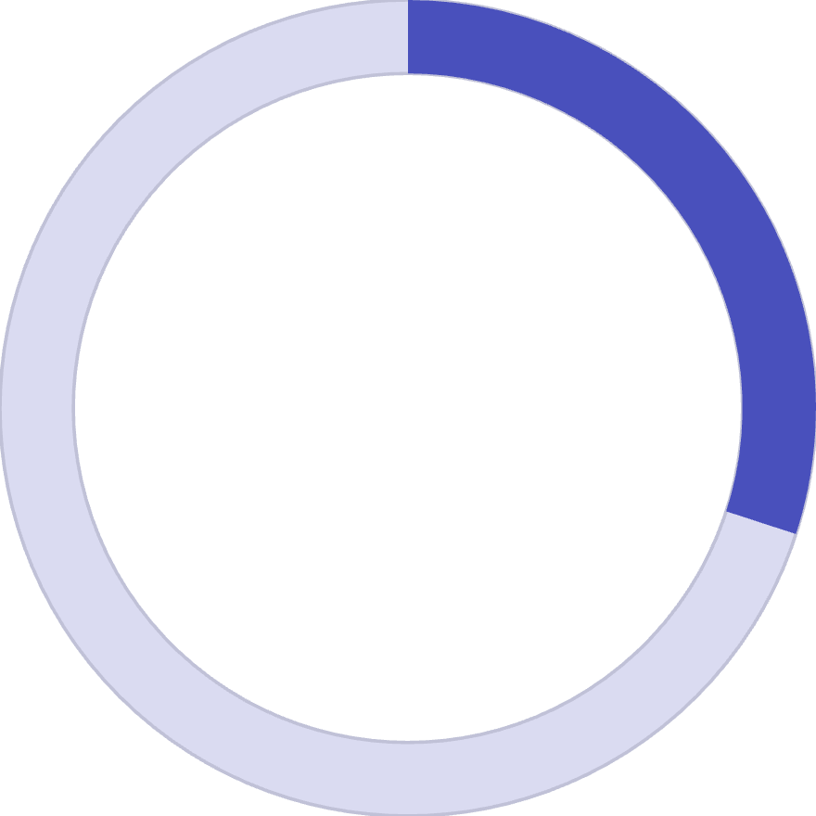
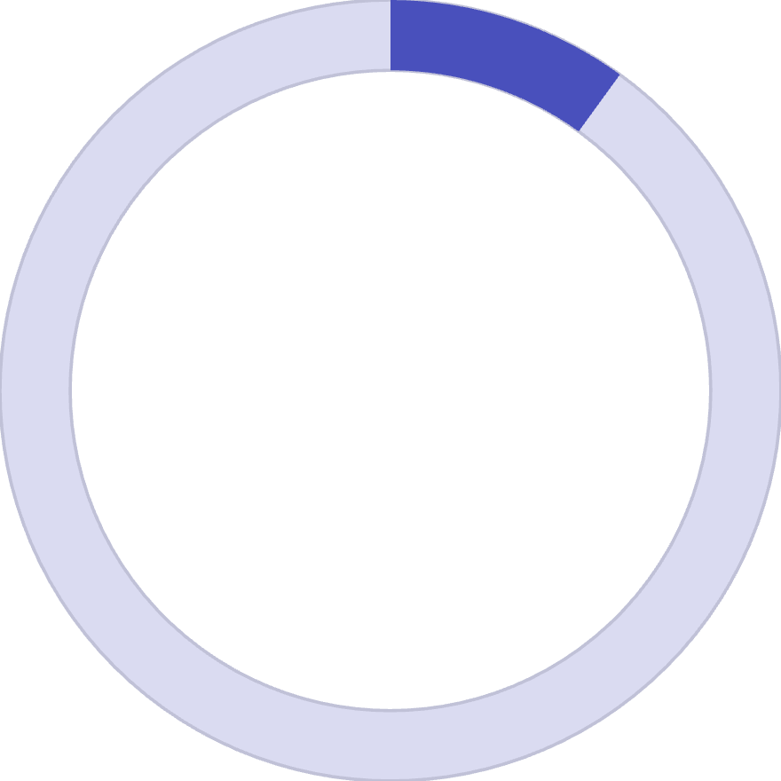
Satisfaction Metrics
22.57%
30%
10%
Average Response Rate
Good Ratings
Excellent Ratings
Across all surveyed facilities
Patients rating experience as "Good"
Patients marking experience as "Excellent"
Average patient satisfaction ranges between 3.0 and 3.5 stars, with higher linear mean scores correlating with improved star ratings.

Slide 9
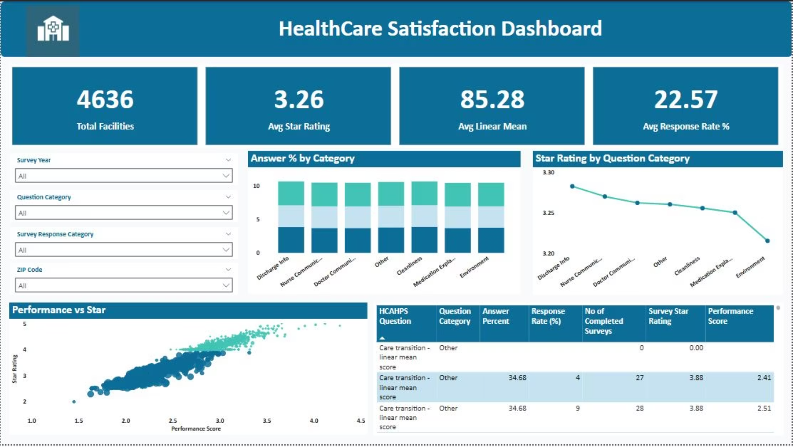
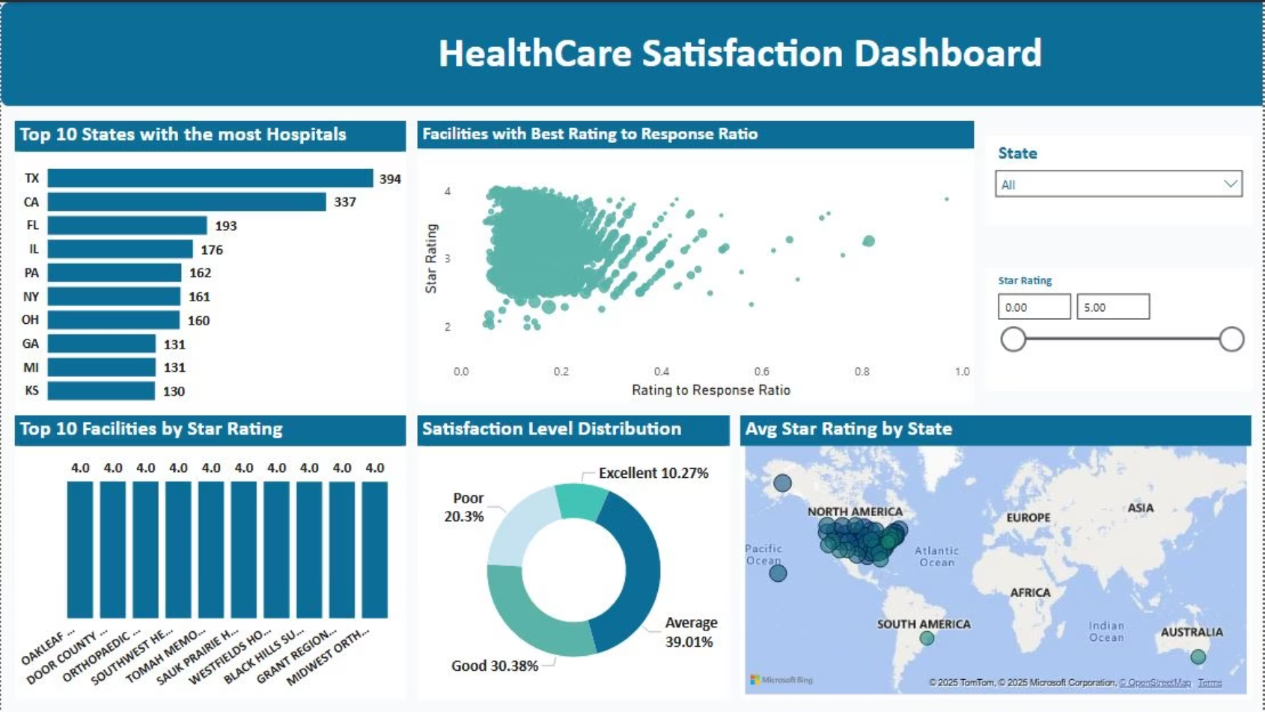
Power BI Dashboard
Built interactive visualizations to present insights across multiple dimensions:
Overview Dashboard
Performance Analysis
State-wise distribution, satisfaction trends, and response rates
Facility rankings, question categories, and year-wise trends

Slide 10

Key Insights & Recommendations
Geographic Concentration
Texas, California, and Florida lead in facility count, requiring targeted regional strategies
Satisfaction Correlation
Higher linear mean scores directly correlate with improved star ratings
Engagement Opportunity
Some facilities show low response rates despite high satisfaction—scope for improved patient engagement
Performance Distribution
Over 30% rate experiences as Good, 10% as Excellent—room for quality improvement initiatives

